Slide 1
Jeans

Slide 2
HAT

Slide 3
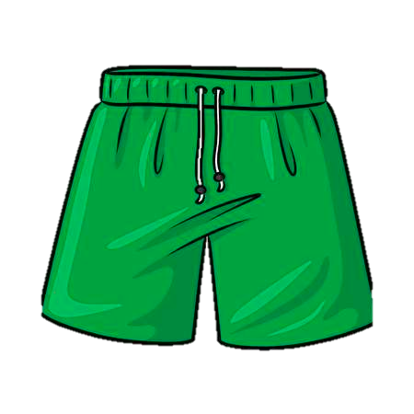
shorts

Slide 4
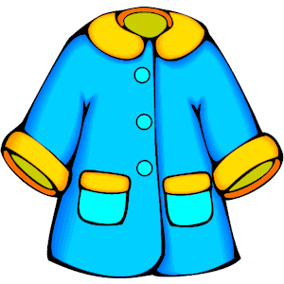
coat

Slide 5
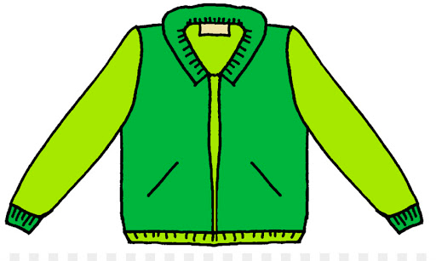
jacket

Slide 6
socks

Slide 7
Trainers

Slide 8
glasses

Slide 9
T-shirt

Slide 10
gloves

Slide 11
scarf

